Slide 1
Revolute joints in any loop can be replaced by prismatic joints with no change in DOF of the mechanism, provided that at least two revolute joints remain in the loop.
If all revolute joints in a fourbar linkage are replaced by prismatic joints, the result will be a two-DOF assembly. Also, if three revolutes in a fourbar loop are replaced with prismatic joints, the one remaining revolute joint will not be able to turn, effectively locking the two pinned links together as one. This effectively reduces the assembly to a threebar linkage which should have zero DOF. But, a delta triplet with three prismatic joints has one DOF-another Gruebler's paradox.

Slide 2
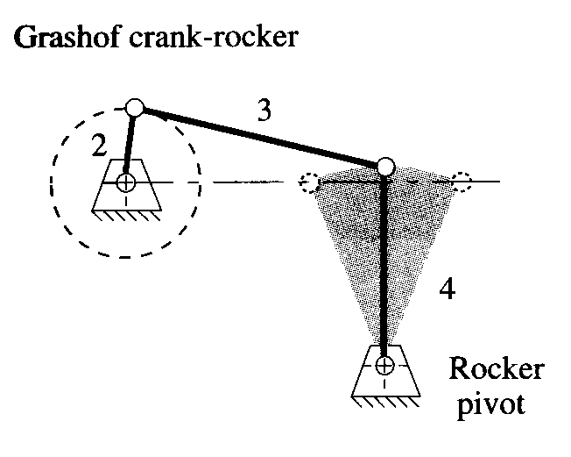
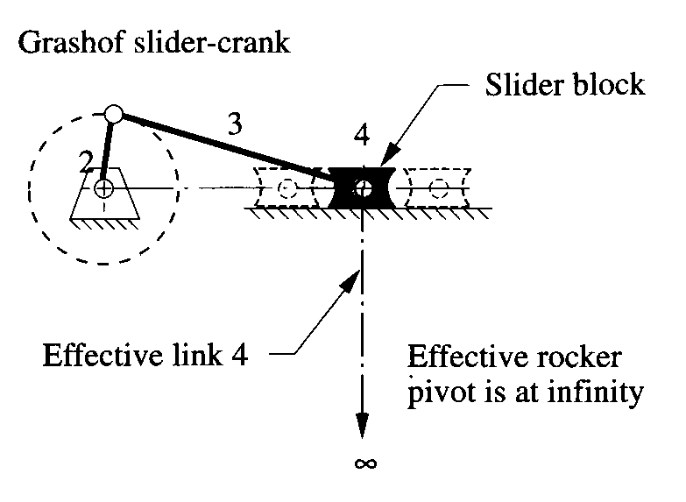
Revolute joints in any loop can be replaced by prismatic joints with no change in DOF of the mechanism, provided that at least two revolute joints remain in the loop.

Slide 3
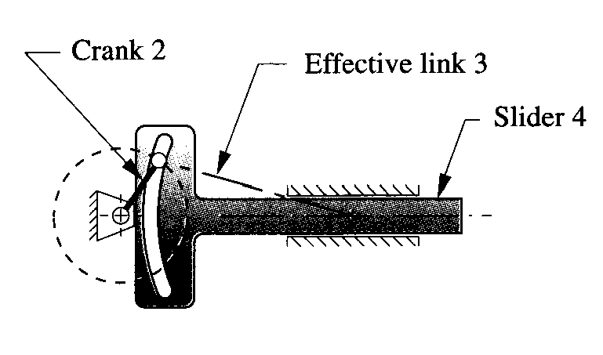
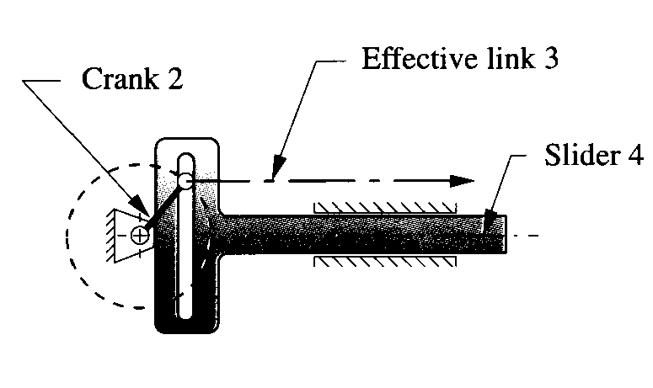
Revolute joints in any loop can be replaced by prismatic joints with no change in DOF of the mechanism, provided that at least two revolute joints remain in the loop.

Slide 4
Any full joint can be replaced by a half joint, but this will increase the DOF by one.
Removal of a link will reduce the DOF by one.
The combination of above will keep the original DOF unchanged.
Example : Pin in slot to Slider block with pin joint in slider joint

Slide 5
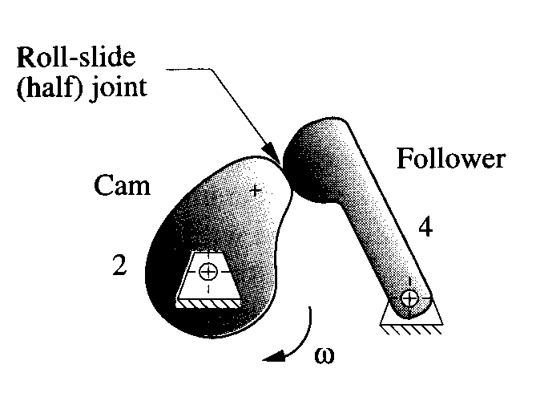
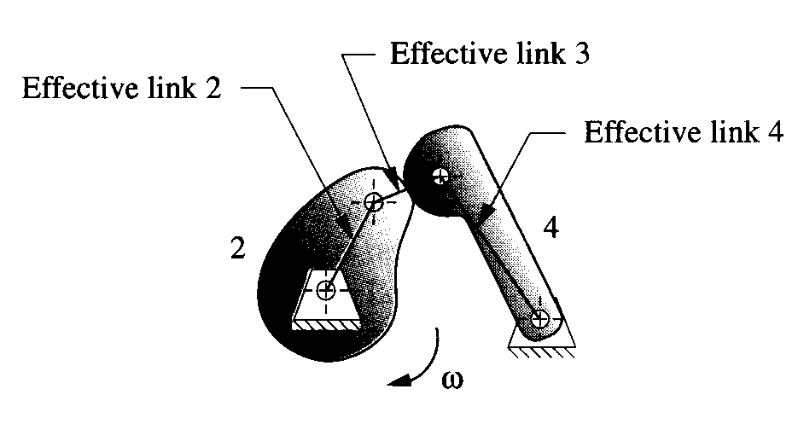
Any half joint can be replaced by a full joint, but this will decrease the DOF by one.
Addition of a link will increase the DOF by one.
The combination of above will keep the original DOF unchanged.

